Slide 1

GCD FORECAST
THE NEW WEATHER APPLICATION FOR DESKTOP
AISHWARYA GUPTA 1DS17TE003
DIVYA P HATHWAR 1DS17CS035
CHANDANA VIJAYAKUMAR 1DS17CS033
GAURI PANDIT 1DS17CS038

Slide 2
ABSTRACT
The main objective is to develop an application for the end user to access weather of any location of their choice of that particular day.
Also, to provide accurate information to the user who’s seeking it irrespective of location.
We will be using Openweather map API which is a free API that has restrictions on number of API calls per minute in the free package.
We will be building a fairly simple and user-friendly application that will help the user’s view the live weather data for a desired city.

Slide 3
TABLE OF CONTENT
Introduction 4
Design/ Implementation 5
Result/Analysis 8
Conclusion 11
Future Work 12
References 13

Slide 4
INTRODUCTION
Weather forecasting is the application of science and technology to predict the conditions of the atmosphere for a given location and time.
We will use API, an application programming interface (API) is a set of subroutine definitions, communication protocols, and tools for building software.
Just as a graphical user interface (GUI) makes it easier for people to use programs, application programming interfaces make it easier for developers to use certain technologies in building applications.
Weather depends on things at small and large scales. In addition, the topographic and oceanic complexity of the earth’s surface makes any long range forecasting beyond a few weeks near impossible and any specific forecasting for local effects like showers limited to.
This website provides an accurate and precise weather forecast of any location that we desire.

Slide 5
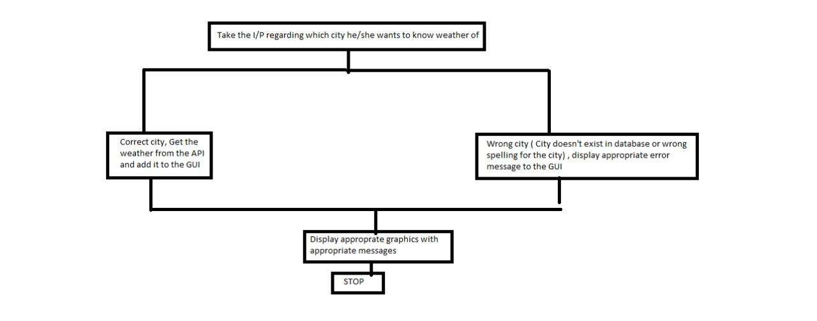
DESIGN AND IMPLEMENTATION

Slide 6
We have used Java Swing to build our GUI. The javax.swing package provides classes for java swing API such as JButton, JTextField, JFrame, JLabel, etc.
On launching the application, the window frame is displayed asking the user’s input to which city’s weather forecast he/she wants.
On pressing the submit button, The event is passed to every ActionListener object that registered to receive such events using the component's addActionListener method.
The JOptionPane class is used to provide dialog boxes such as message dialog box, confirm dialog box and input dialog box.
If the entered input is the existing city in the API, a different class is called to perform the event. We are using JSON Parsing for displaying the data from the server to the user.

Slide 7
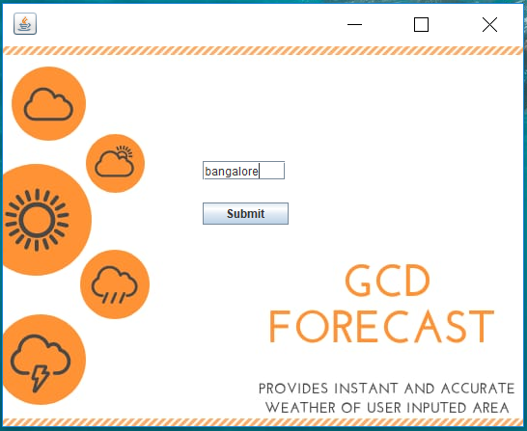
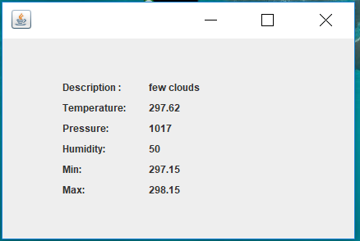
RESULT/ ANALYSIS
Figure 1
Here, the user’s input was bangalore. Once the input was submitted, the following results were displayed based on the current atmospheric conditions during that time.

Slide 8
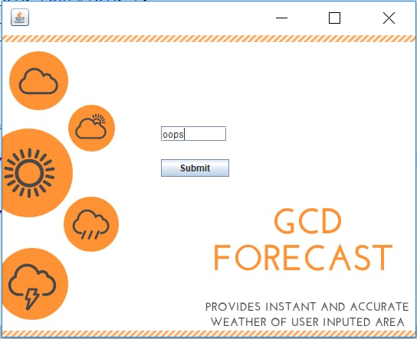
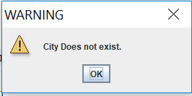
RESULT/ ANALYSIS
Figure 2
Here,the user’s input was completely invalid.
Hence, it displayed the appropriate error message to the user.

Slide 9
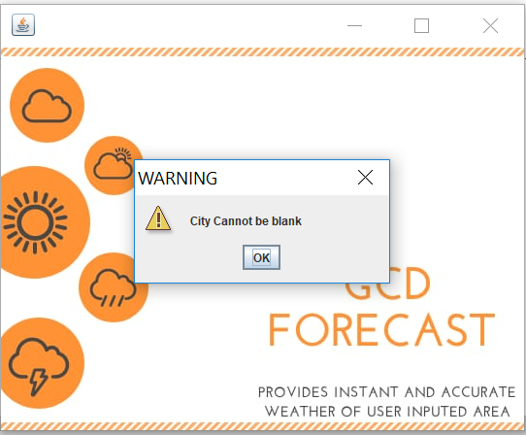
RESULT/ ANALYSIS
Figure 3
Here it shows you a warning message issued by the application when the city field is submitted without the appropriate city name.

Slide 10
CONCLUSION
GCD Forecast for java enabled desktop is expected to work successfully on all types of operating systems.
The application is small and free which makes usage easy.
User can selectively and interactively access the desired data, no matter where the person is.

Slide 11
FUTURE UPDATES
In the future updates there will be auto detecting location, showing weather forecast for the coming week, showing past weather trends and alert for weather changes.

Slide 12
REFERENCES
https://stackoverflow.com/questions/1466240/how-to-set-an-image-as-a-background-for-frame-in-swing-gui-of-java
http://java-demos.blogspot.com/2012/09/setting-background-image-in-jframe.html?m=1
https://dzone.com/articles/how-to-parse-json-data-from-a-rest-api-using-simpl
https://www.youtube.com/watch?v=KdTsY3G_To0
Calkins, J., M. R. Peroutka, R. K. Meiggs, and J. P. Lang, 1998: Creating NOAA Weather Radio broadcast scrips using interactive forecast preparation. https://www.javatpoint.com/java-swing
Dickman, I. R., 2002: NWS Eastern Region Interactive Forecast Preparation System (IFPS) Implementation. Preprints, Interactive Symptom on the Advanced
Weather Interactive Processing System (AWIPS), Or- lando, FL, Amer. Meteor. Soc., 28-32.
www.api.openweathermap.org/data/2.5/weather?q={city name}

